Slide 1
P1: Pipelined 32 & 64 bit signed integer multiplier
CS6230: CAD for V.L.S.I
Aneesh S EE23E009 ( B.Tech EE)
Github

Slide 2
Outline
Pipelining
Signed Binary Multiplication logic
Code
Test Bench

Slide 3
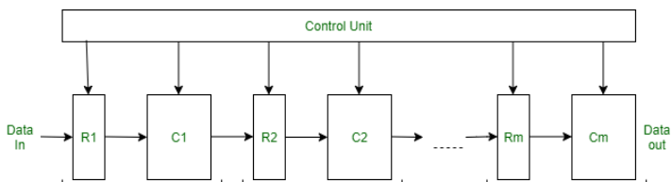
Introduction
Pipelining
  a design technique that enhances the throughput of a digital system.
  by dividing the execution of instructions which performs specific operations into discrete stages
  multiple instructions are processed concurrently
  This results in improved overall system performance.

Slide 4
Signed Binary Multiplication
Case 1: Multiplicand: +ve and Multiplier : +ve
Case 2: Multiplicand: -ve and Multiplier : +ve
Case 3: Multiplicand: -ve and Multiplier : -ve
Case 4: Multiplicand: +ve and Multiplier : -ve

Slide 5
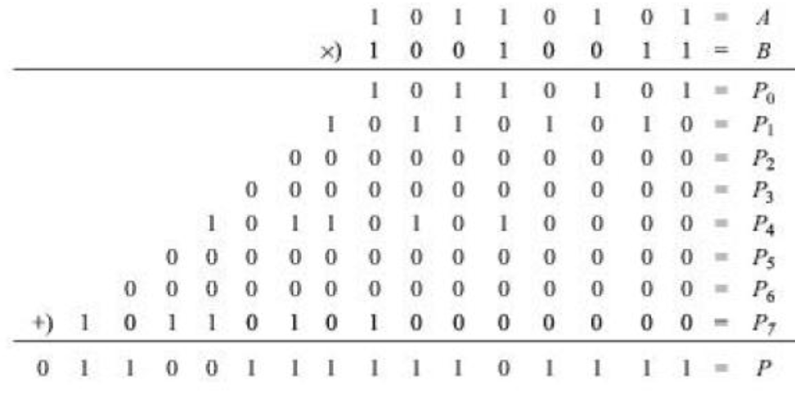
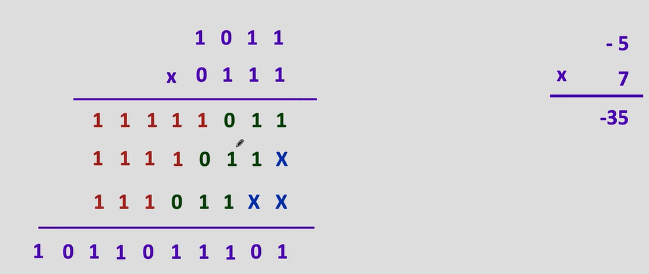
Case 1
Case 2
Case 1
Represent numbers in binary form
Represent numbers in binary form (taking the 2’s complement of multiplicand)
Starting from the right most bit and move to the left of the multiplier, multiply with the multiplicand
Starting from the right most bit and move to the left of the multiplier, multiply with the multiplicand
Starting from the right most bit and move to the left of the multiplier, multiply with the multiplicand
Starting from the right most bit and move to the left of the multiplier, multiply with the multiplicand
Case 2
Move the digits left by 1 unit after every multiplication and create individual pipelines
Concatenate n bit 1’s after each multiplication and shift to make the pipelines to be of equal length
Add the pipelines, take the 2’s complement of the number obtained
Add the pipelines to get the result

Slide 6
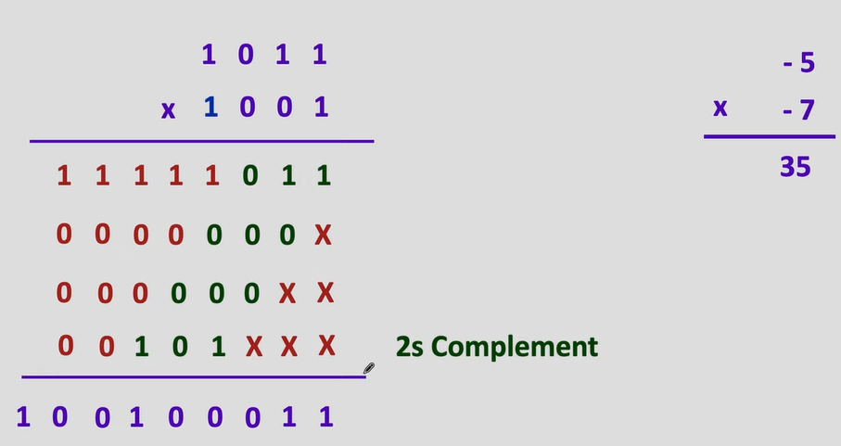
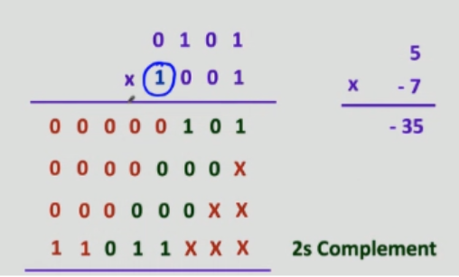
Case 3
Case 4
Case 3
Represent numbers in binary form (taking the 2’s complement of multiplicand)
Represent numbers in binary form (taking the 2’s complement of multiplicand)
Represent numbers in binary form (taking the 2’s complement of multiplicand)
Represent numbers in binary form (taking the 2’s complement of multiplicand)
Starting from the right most bit and move to the left of the multiplier, multiply with the multiplicand
Starting from the right most bit and move to the left of the multiplier, multiply with the multiplicand
Case 4
Take the 2’s complement of the multiplication of LSB and the multiplier
Concatenate n bit 0’s after each multiplication and shift to make the pipelines to be of equal length
Add the pipelines to get the result
Take the 2’s complement of the multiplication of LSB and the multiplier

Slide 7
Bash Statements
To create a .bo file and compile Verilog codes:
  bsc -verilog bit_signed_multiplier.bsv
  To compile test bench:
    bsc -o sim -e mkTestbench mkMultb1.v
    To generate synthesis file:
    Yosys –o output.blif –S mkMultb1.v

Slide 8
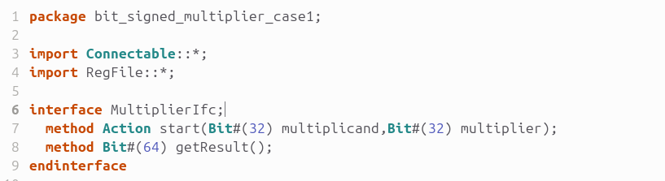
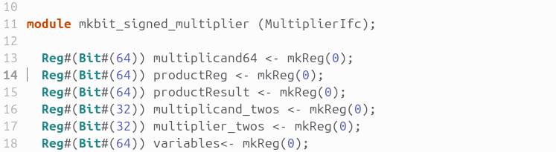
Code
Package declaration named bit_signed_multiplier_case1.
Importing modules required
Define an interface to do the necessary operations.
Module containing registers used during the process
Github

Slide 9
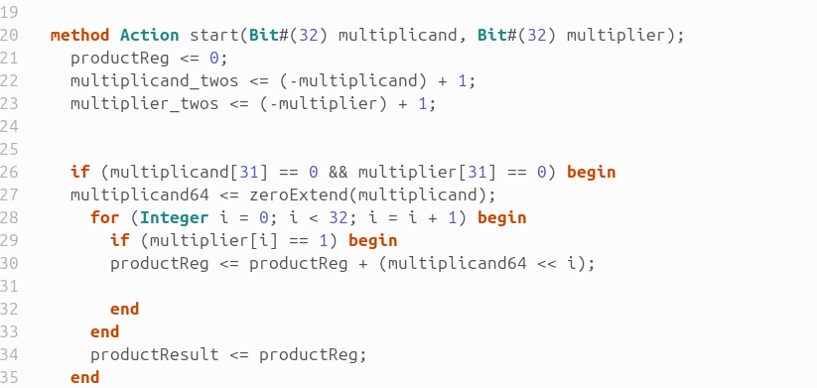
Code
Beginning the method containing the
logic for signed multiplication
Case1: Multiplicand: +ve and Multiplier : +ve

Slide 10
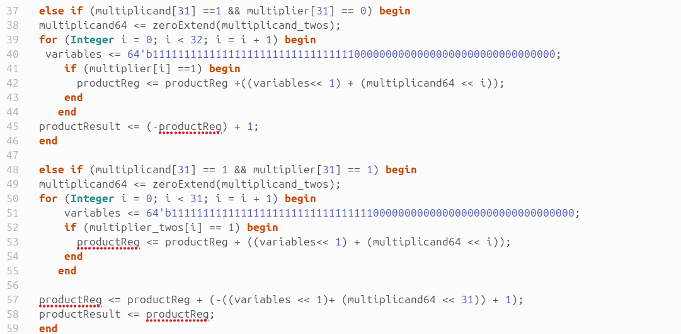
Code
Case 2: Multiplicand: -ve and Multiplier : +ve
Case 3: Multiplicand: -ve and Multiplier : -ve

Slide 11
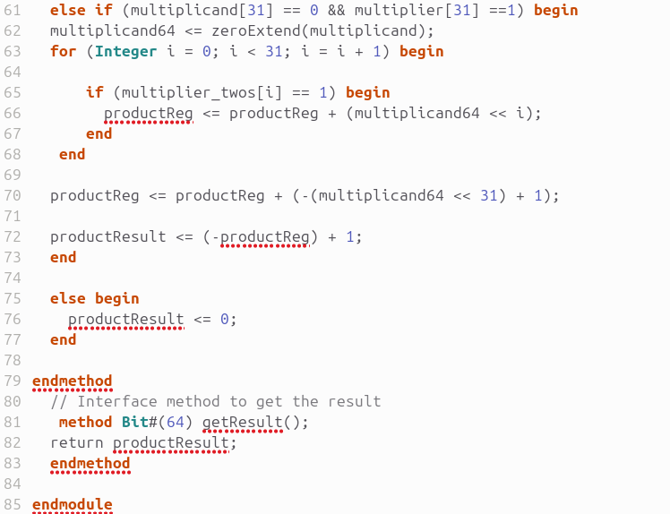

Code
Case 4: Multiplicand: +ve and Multiplier :-ve
Using the method to get the product result.

Slide 12
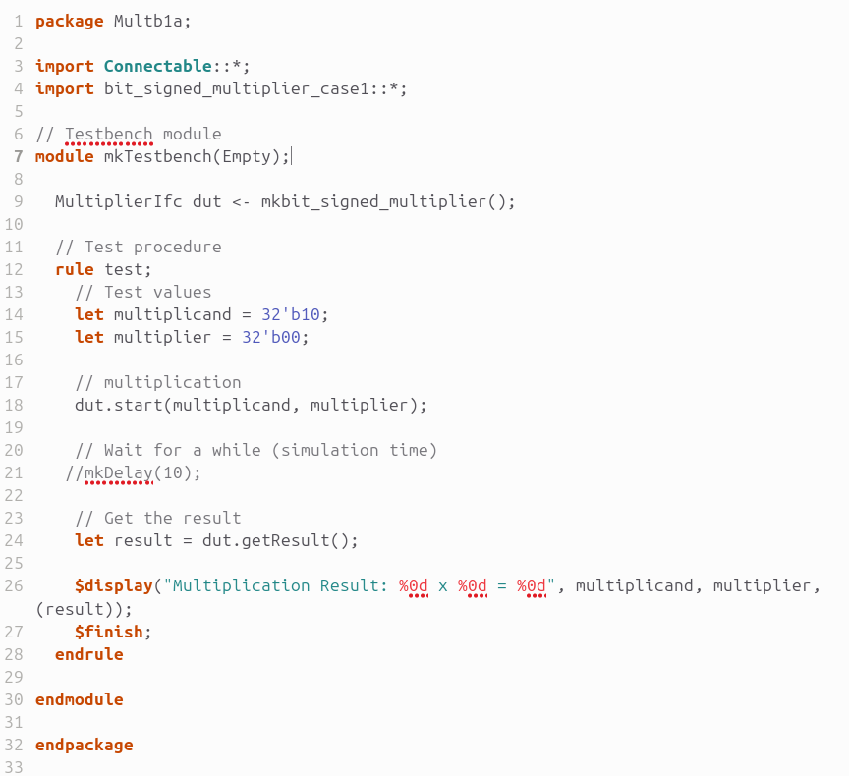
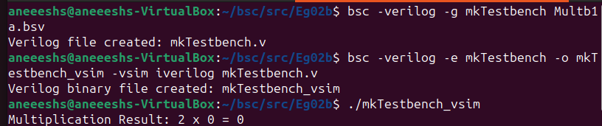
Test Bench
Defining a test bench to test the
Code.
Take two 32 bit inputs
Eg: multiplicand: 2 (010)
Multiplier: 0 (000)
Result = 0 (000).

Slide 13
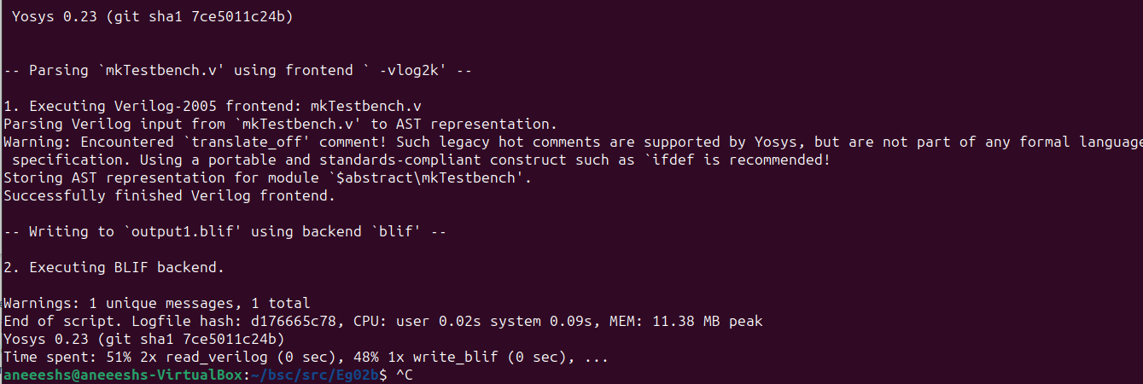
Synthesis report
The synthesis report was generate using $ yosys –o output.blif –S mkTestbench.v
Command. It is also uploaded on the repository.

Slide 14
Conclusions
This code uses partial product concept to illustrate pipelined signed multiplication.
It is an efficient and concise process.
It can however be improved by using algorithms like Booths method to reduce the computation time in arriving at results.

Slide 15
References
Note: Kindly read the following about the repository made. This gives an overview of the inputs (references) and outputs, the
(code file namely: "Aneesh_P1_CS6230.ppt", consisting of the output and all the physical constrains considered, and output obtained) and
(the synthesis file named: "output.blif")
The synthesis file was run, and is uploaded named: "output.blif". You will be able to find the files in the repository.
The references used in the coding are as follows:
1)Video: Signed Binary Mulitplication (only theoritical concept)
2) "Digital Electronics" a textbook by Morris Mano
3) http://courses.csail.mit.edu/6.111/f2008/handouts/L09.pdf -the slide handouts - concptual
4) The documentation provided during the course about Bluespec SystemVerilog.
*****

Slide 16
THANK YOU

